Slide 1

Pinecrest People Mover App
Maurice Pruna
FIUSCIS-Senior Project

Slide 2
Prepared by:David Plummer & Associates

Slide 3
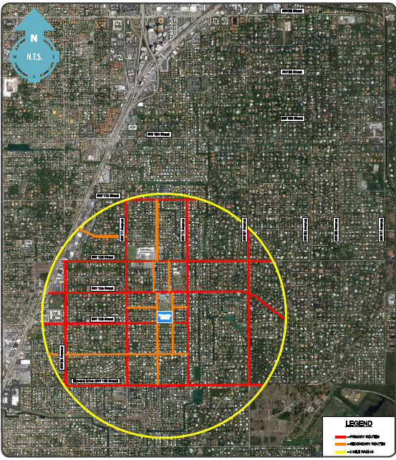
Palmetto Middle School

Slide 4
Problems
Create the same application for three different platforms
Android
IOs
Web App
Use the bus information from the GPS system provider
Accomplish client requirements

Slide 5
Solution
http://pm-dev.cs.fiu.edu/peoplemover
Using the app the user is able to:
Display Hours of Operation
Receive Trolley Alerts
Set Favorite Stop
Remove Favorite Stop
List Stops for a specific route
Login
Register
Request Stop
Report Problem
Send Feedback
Receive Trolley Arrived to Location Alert

